Slide 1
Project
Movie rental store.
Rahul Mutalik

Slide 2
Main Objective
The Objective is to analyse the data of a movie rental store for further growth and improvement in the business

Slide 3
Secondary Objective
Help the Store to Analyse which What kind of Movies are often rented , which genre they belong to , and which actors appeared in them.
so that store can stock up the inventory as per Audience preference for improvement in their business

Slide 4
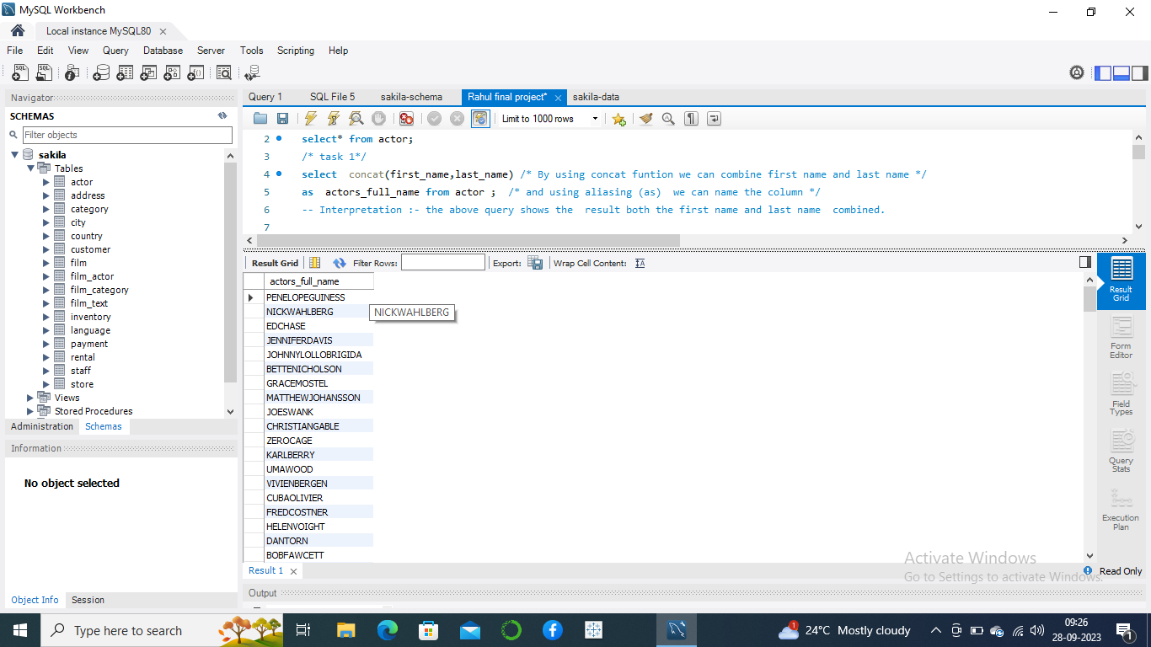
Display Full Name of each actor

Slide 5
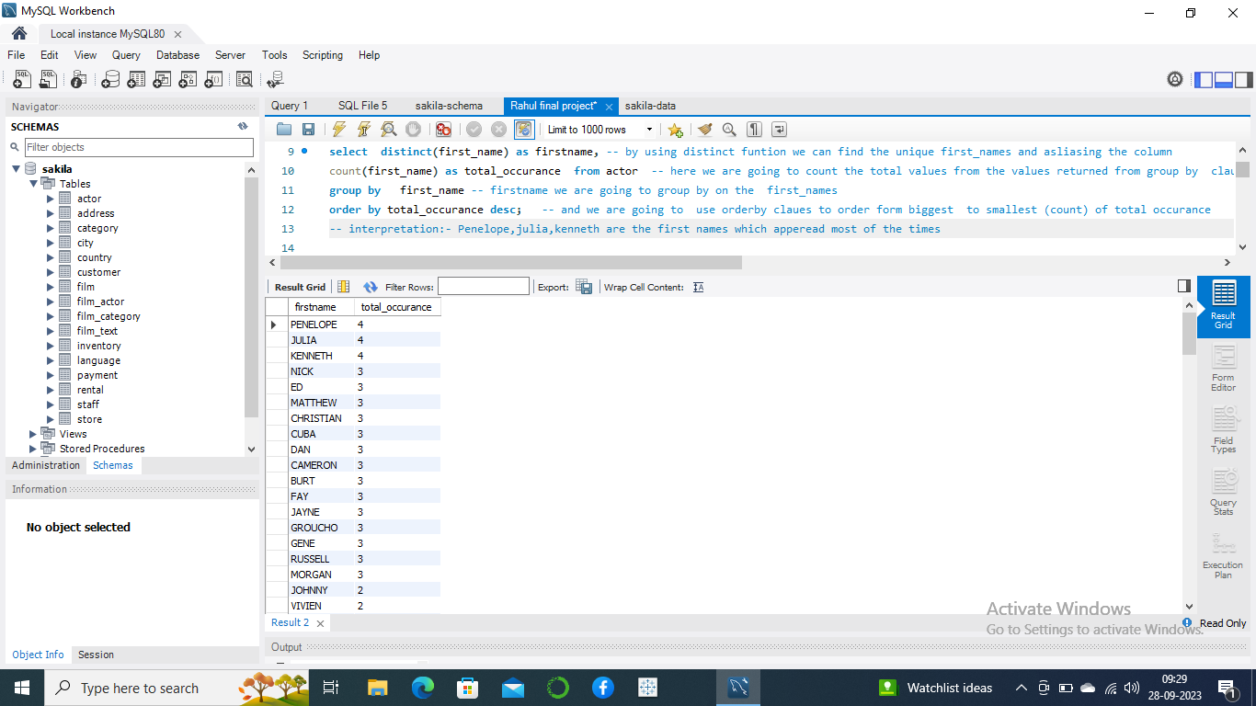
Display first names of actors which are appearing frequently
PENELOPE,JULIA,KENNETH have highest no of total occurance

Slide 6

Display last names of actors which are appearing frequently
Kilmer , Nolte, Temple has most amount of total _occurrence

Slide 7
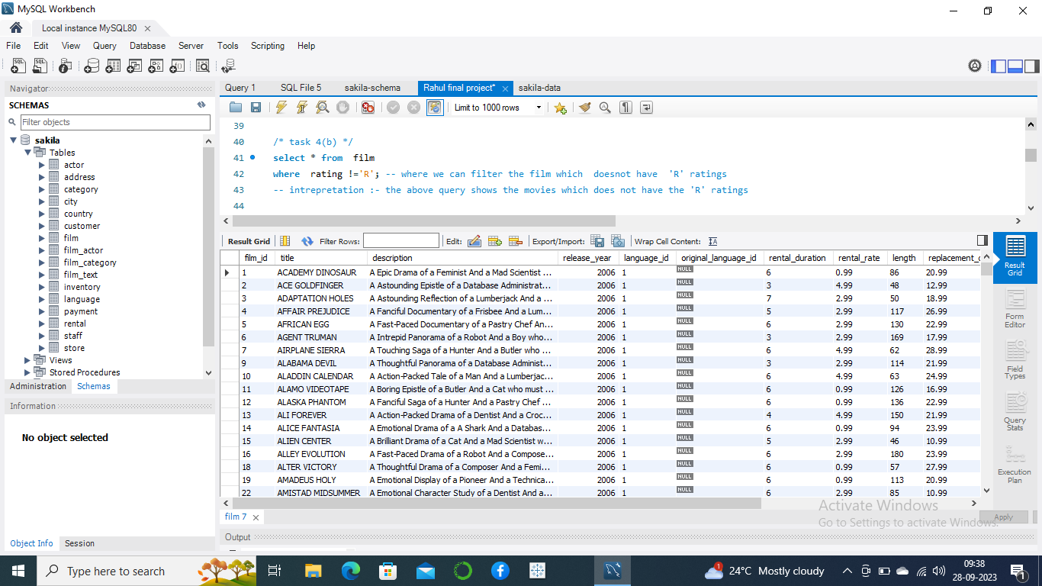
Display List of Movies which are not rated as ‘R’
These films are Suited for the Audience below 17 years of age

Slide 8
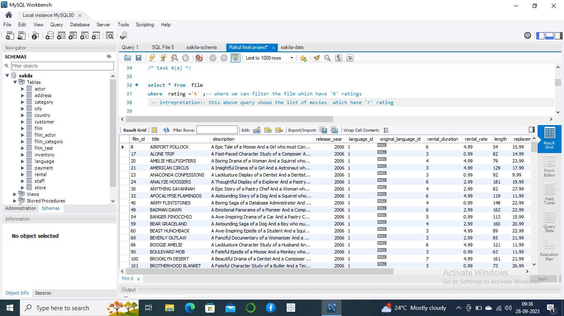
Display List of Movies which are rated as ‘R’
These films are not Suited for the Audience below 17 years of age

Slide 9

Display movies which are suited for the audience below 13
Above Listed movies are suited for age group below 13 years of age

Slide 10

Display the list of movies which have replacement cost below (11)
Movies list where replacement cost is pretty low as it would help the customers for savings

Slide 11
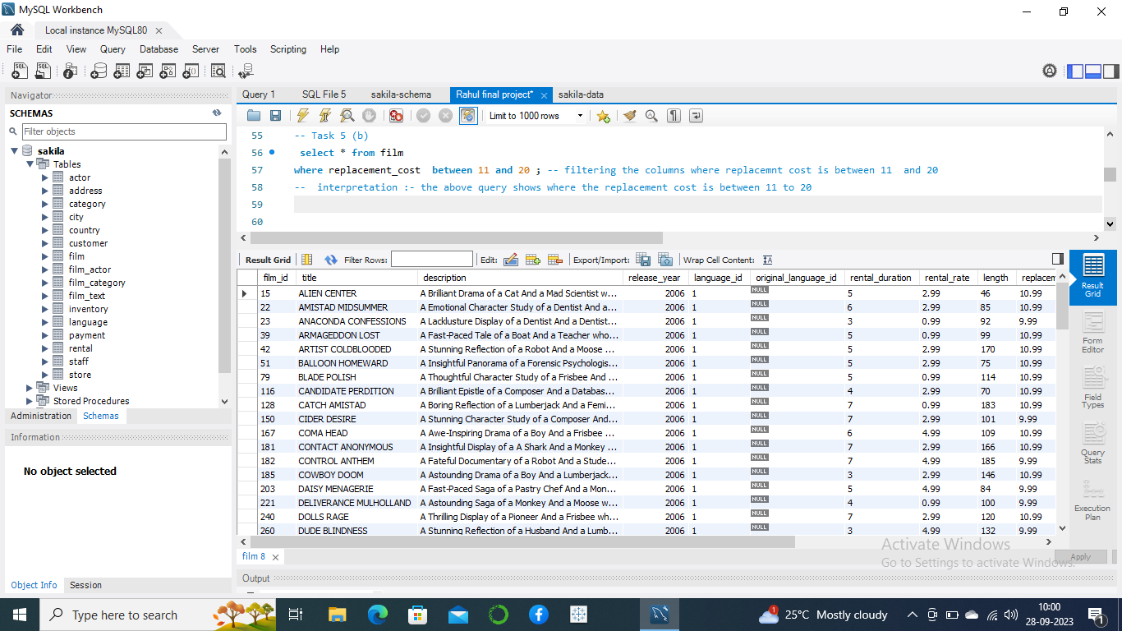
Display the list of movies which have replacement cost between 11 to 20

Slide 12
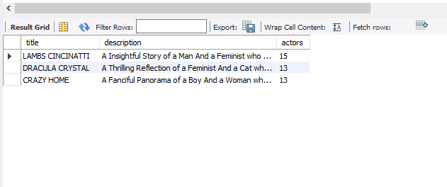
Display top 3 movies with Highest no of actors
LAMBS CINCINATTI, DRACULA CRYSTAL , CRAZY HOME are the movies which have highest no of actors

Slide 13
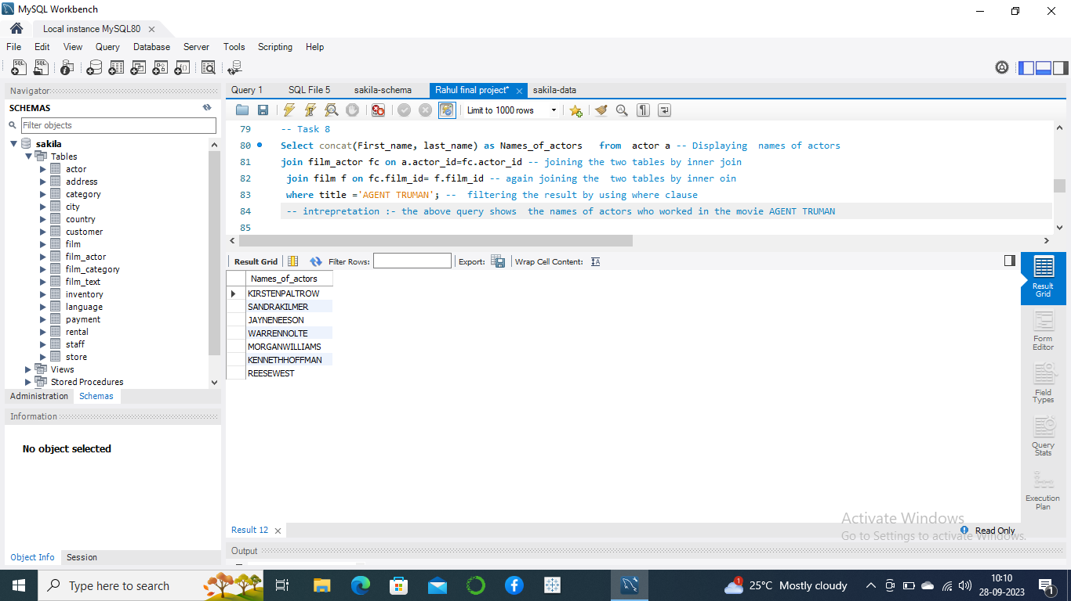
Display the names of all the actors who appeared in the film ‘Agent Truman’
AS Film Agent Truman was the great success the above is the list of actors
who have worked in that film.

Slide 14
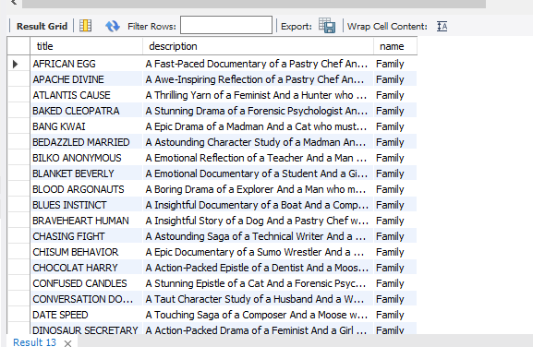
Identify all the movies categorized as family films
Sales were lagging among young families , so here are the list of movies were the store can use to promote family movies

Slide 15
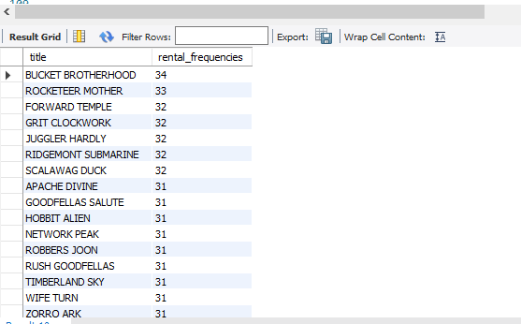
Display the movies with their rental Frequencies
BUCKET BROTHERHOOD has highest rental frequencies so Store need to
stock up with their inventory with that movie so it would increase their
profit .

Slide 16
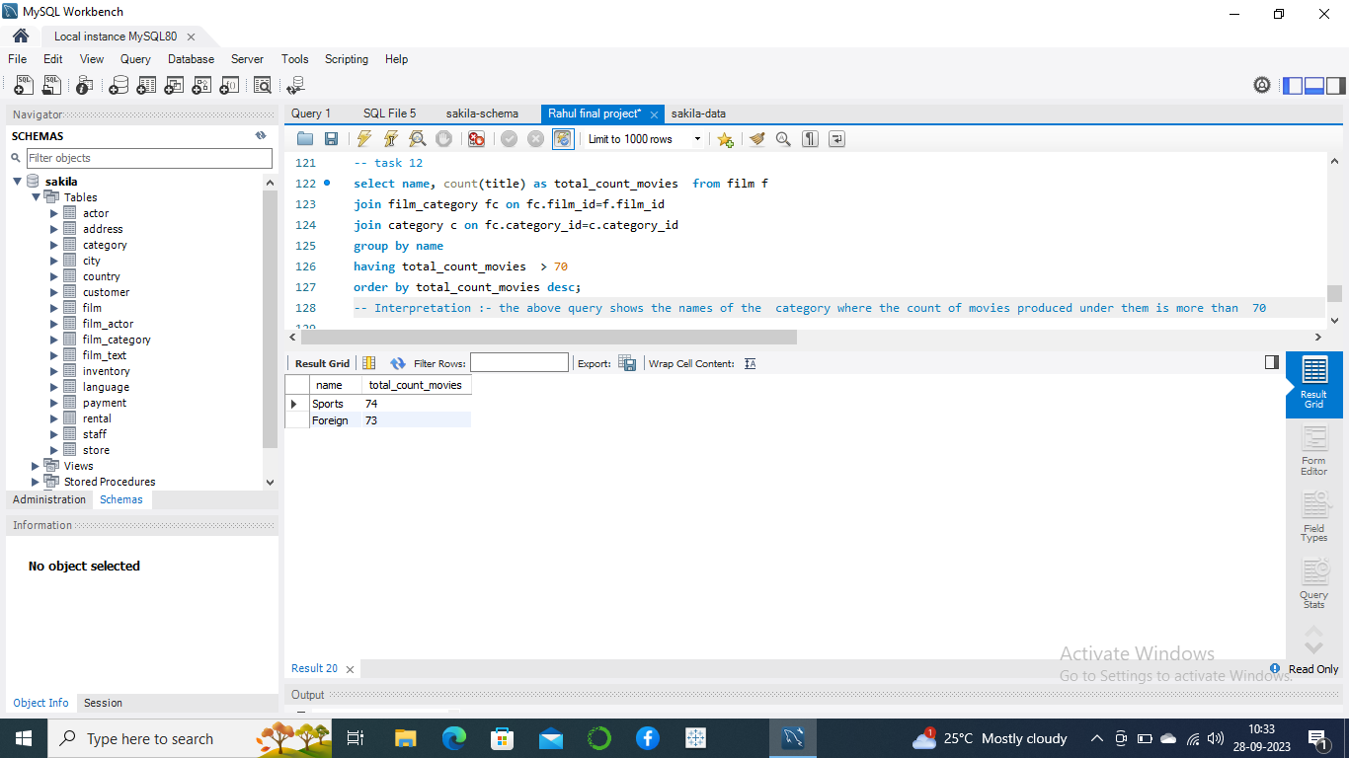
Display the film Categories in which the number of movies is greater than 70
Sports and Foreign category have most amount of movies , so store can have variety of movies to stock up in their inventory

Slide 17
Observations
Sports and Foreign category have most amount of movies , so store can have variety of movies to stock up in their inventory.
LAMBS CINCINATTI, DRACULA CRYSTAL , CRAZY HOME are the movies which have highest no of actors.
Recommendations
BUCKET BROTHERHOOD has highest rental frequencies so Store need to stock up with their inventory with that movie so it would increase their profit .

Slide 18
Thank you

